Slide 1
Feature Selection

Slide 2
Plan
Presentation
Statistics-Based
Recursive Elimination
L1 regularization
Tree-Based
Tutorial
Exercise
Feature Selection In Python tutorial
Feature Selection in scikit
Intro to feature selection (for FAQ)
Overview of feature selection articles
Vorontsov lecture
Feature Importance in Trees
Elastic Net Justification

Slide 3
Univariate Feature Selection
Chi-Squared Test (categorical variables)
Anova F-value (linear dependency)
Mutual Information (nonlinear dependency)
Notes:
Statistical Tests return p-values; smaller p-value, the higher probability of a feature being correlated to class variables.

Slide 4
Recursive Feature Elimination
Full Restricted Search
Add-Del Algorithm
Notes:
Full Restricted Search

Slide 5
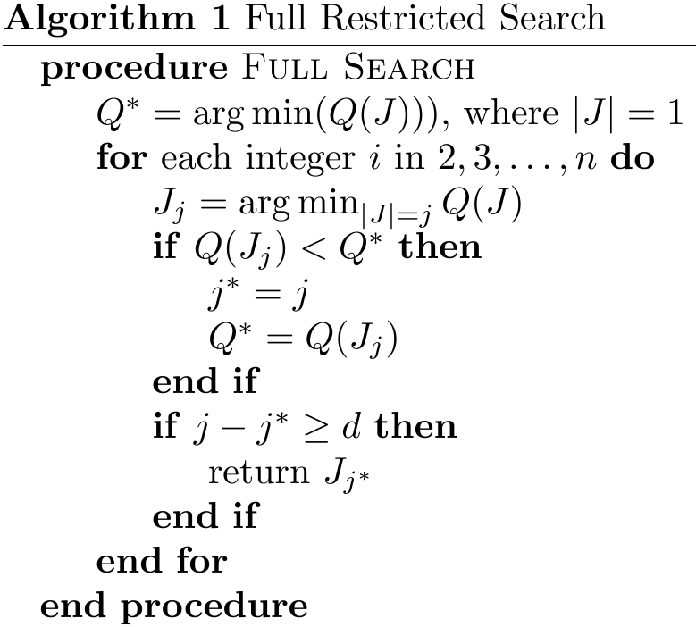
Recursive Feature Elimination
Full Restricted Search
Notes:
Full Restricted Search

Slide 6
Recursive Feature Elimination
Full Restricted Search
Advantages:
Easy to implement
Optimal
Disadvantages:
Feasible for small number of features
Overfitting
Notes:
Full Restricted Search

Slide 7
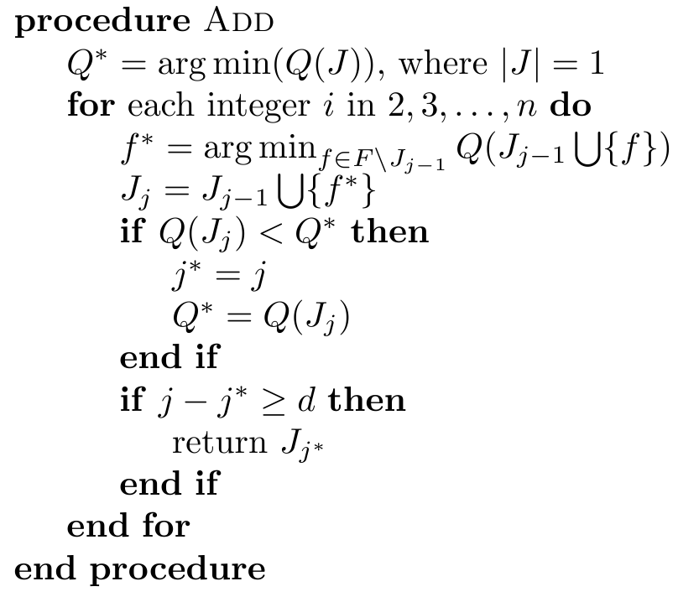
Recursive Feature Elimination
Add Algorithm
Notes:
Full Restricted Search

Slide 8
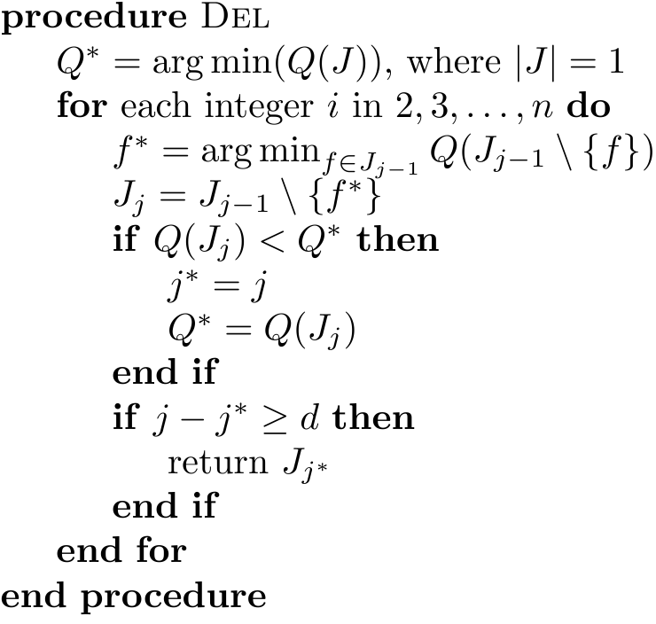
Recursive Feature Elimination
Del Algorithm
Notes:
Full Restricted Search

Slide 9
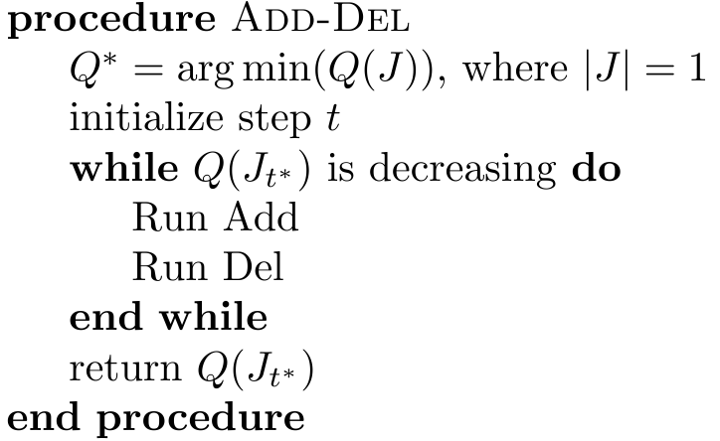
Recursive Feature Elimination
Add-Del Algorithm
Notes:
Full Restricted Search

Slide 10

L1-norm feature elimination
Notes:
With SVMs and logistic-regression, the parameter C controls the sparsity: the smaller C the fewer features selected. With Lasso, the higher the alpha parameter, the fewer features selected.

Slide 11
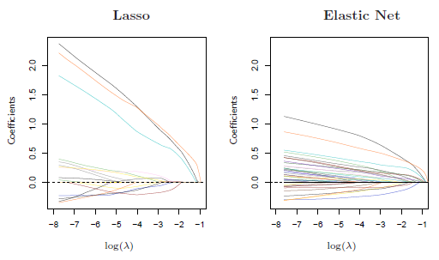
L1-norm feature elimination
Notes:
The lasso penalty is somewhat indifferent to the choice among a set of strong but correlated variables. The ridge penalty, on the other hand, tends to shrink the coefficients of correlated variables toward each other. The elastic net penalty is a compromise between the two, and allows for more than N features to be selected.

Slide 12
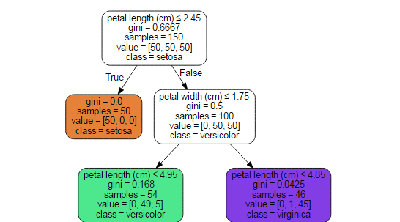
Tree-based feature selection

Slide 13

Tree-based feature selection

Slide 14

Tree-based feature selection

Slide 15

Tree-based feature selection

Slide 16




Tree-based feature selection
Notes:
Impurities are Gini, Cross-Entropy, and Misclassification. Pmk is the number of samples of class k in node m.

Slide 17
Tree-based feature selection
Initialize features with zeros.
For split feature j in node m, compute error = H(m) - H(m_left) - H(m_right)
Multiply error by number of samples reach that node.
Add the resulted quantity to importance of feature j.
Notes:
Impurities are Gini, Cross-Entropy, and Misclassification. Pmk is the number of samples of class k in node m.

Slide 18
Tree-based feature selection
For example, for root node assume we have 100 samples. Then, error = 0.6667 - 0 - 0.5 = 0.16667. And current importance of “petal length” feature is 0.16667*100 = 16.667.
Notes:
Impurities are Gini, Cross-Entropy, and Misclassification. Pmk is the number of samples of class k in node m.

